Slide 1



INTELLIBOT:
AI-POWERED Q&A RAG CHATBOT FOR BUSINESS DATA
TechBridge Hackathon 2025

Slide 2

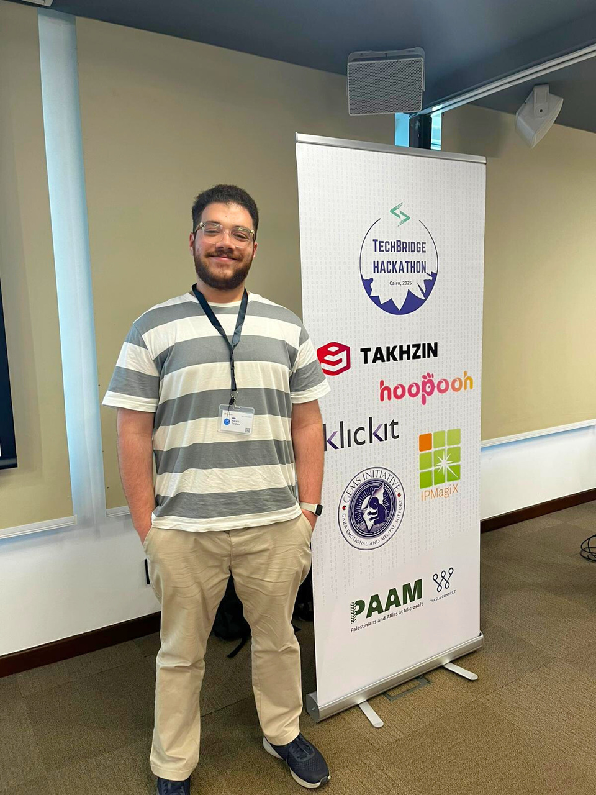



MEET THE TEAM!
Kareem Radwan
Karam Saidam
Yehia Mohamed
Rana Ziara
Salma Sherif

Slide 3
CHALLENGE IN TODAY’S BUSINESS ENVIRONMENT
Organizations generate vast amounts of structured and unstructured data.
Traditional search tools are inefficient, often failing to deliver :
Context-aware answers.
Proper Knowledge .
No privacy / Security Issue.
Time.

Slide 4
API END POINTS IN OUR SOLUTION
Upload Documents (Unstructured Data)
Search Query (For Unstructured Data)
Query the DataBase (Structured Data)

Slide 5
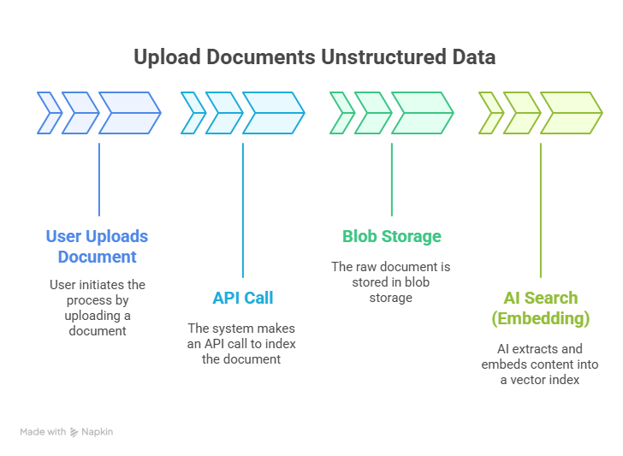
UPLOAD DOCUMENTS UNSTRUCTURED DATA

Slide 6
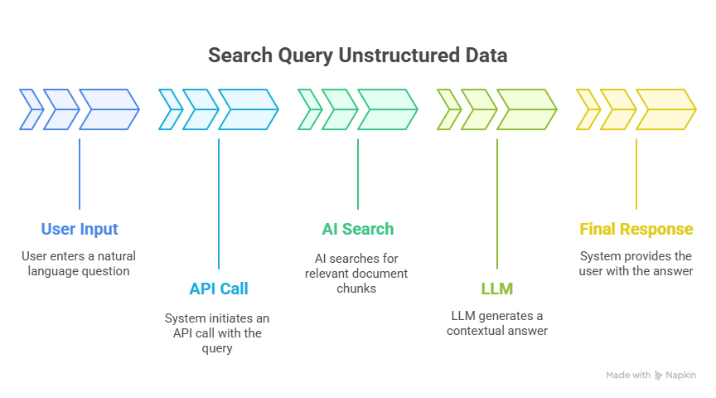
SEARCH QUERY UNSTRUCTURED DATA

Slide 7
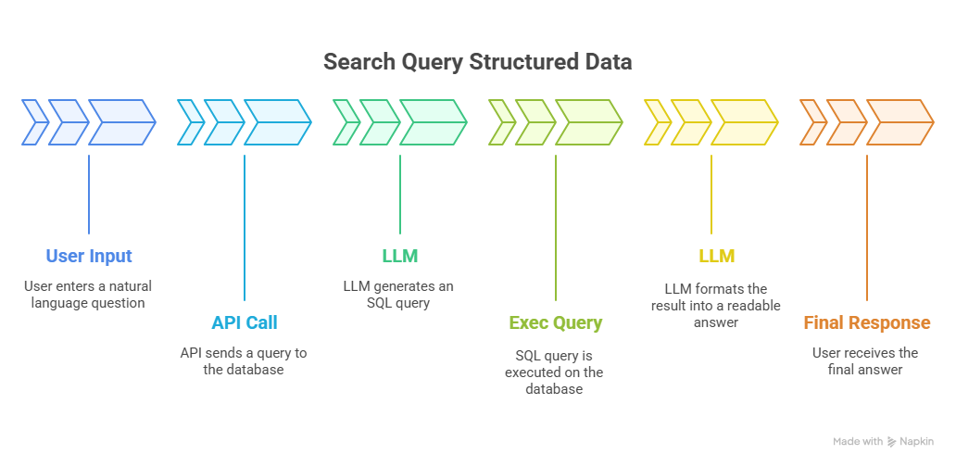
SEARCH QUERY STRUCTURED DATA

Slide 8
MORE FEATURES!!
Multi Orgnaization Management
UI
Data Isolation and Security
Automated Test
Load Test

Slide 9
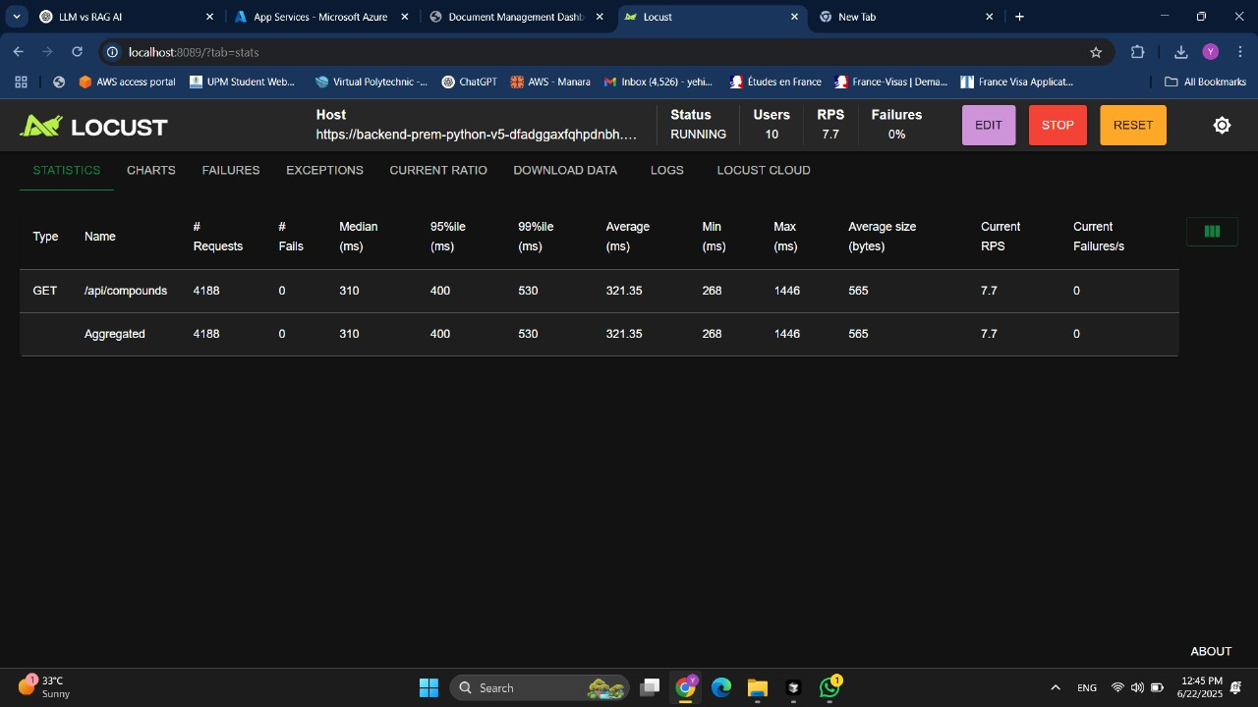
LOAD TEST RESULT

